Slide 1

“Helping needy ones”
Online donation web application
Group Name : G-42
My Team Details:- Member 1 – Sahastranshu Kushwaha (229079)
Member 2 – Utkarsh Upadhyay(229107)

Slide 2
Introduction:
This project is a web-based application where donor can donate either in the form of monetary help or any items like books, clothes e-items, toys etc. If the donor wants to provide monetary help then donor will be directed to the payment gateway page. For item donation, donor has to sign up, fill in details like Name, Address, etc. in the form, select the item various categories like books, cloths, e-items, toys etc., upload picture of donated item in the form and then handover the item to the employee.
After this the employee will collect the item and the employee will distribute it to the needy ones and he will take a picture with the donee this will be visible to only employees. We are doing this for increasing privacy and transparency purpose. With the donated money employee will raise the bids for books, clothes, etc. and the best of 5 vendors on the basis of quality 1 will be selected, after receiving the items the money will be transferred automatically to the vendors and every month to the salary of employee will be transferred automatically.

Slide 3
The project objective is to deliver the basic items like notebooks, clothes etc. to the needy specifically children. Helps to regrow the emotions in a person and by donating, one’s life will be improved and donor will feel self-satisfaction by doing this kind thing. Help the local vendors by promoting their business through the process of this project .A complete and efficient web application which can provide the user friendly donation facility and transparency in donation is the basic objective of the project.

Slide 4
Scope of Project
TECHNOLOGIES USED
Spring Boot
Spring Boot JPA
React
MySQL

Slide 5
FEATURES
Category of items for donation-Books, Clothes, Toys, E-Items etc.
Anonymous donor can donate money also.
Vendor bids for tender available.
Employee select the best vendor and collect the items and distribute the item to the donee/needy.
24x7 online money donation available.

Slide 6
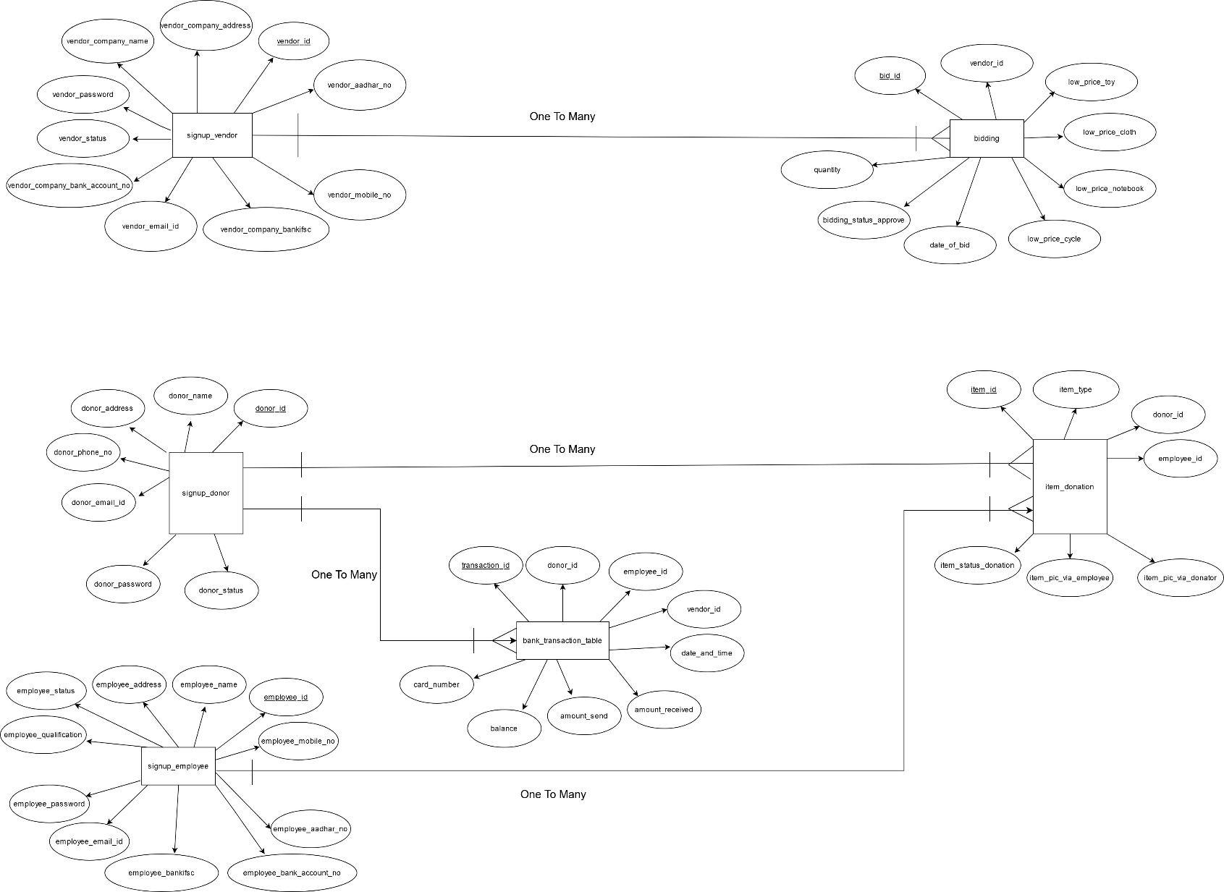
ER Diagram

Slide 7
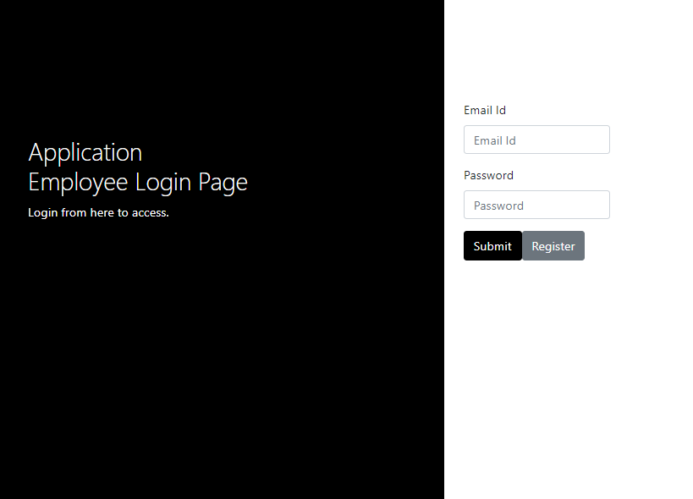
Employee:
● Sign Up
● Sign In/Sign Out
● Vendor table
● Donor table
● Receive item from donor
● Receive item supplied from
vendor
● Deliver item to donee
● Maintain database

Slide 8
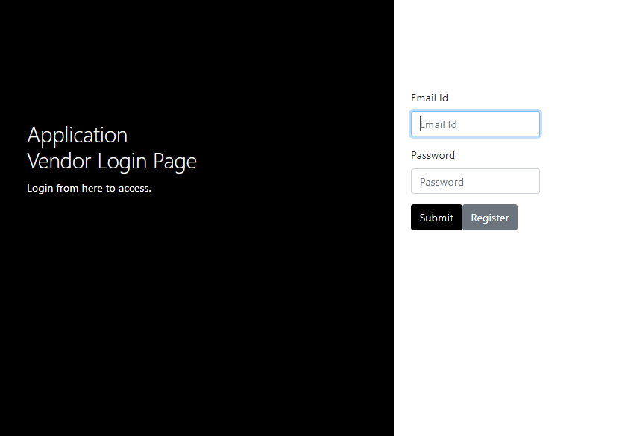
Vendor:
● Sign Up
● Sign In/Sign Out
● Apply for bid
● Can bid for multiple items
● Can check if selected for bid or not

Slide 9
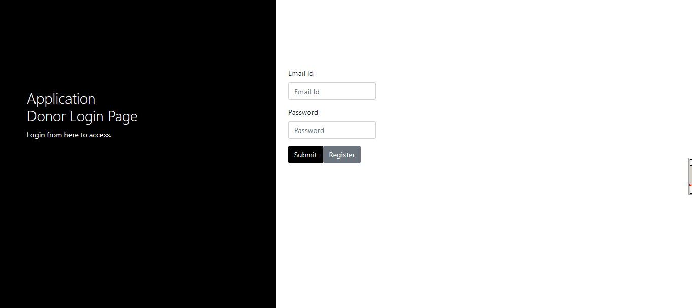
DONOR:
● Sign Up
● Sign In/Sign Out
● Update Profile
● Can select from books, clothes etc.
● Can donate money also

Slide 10
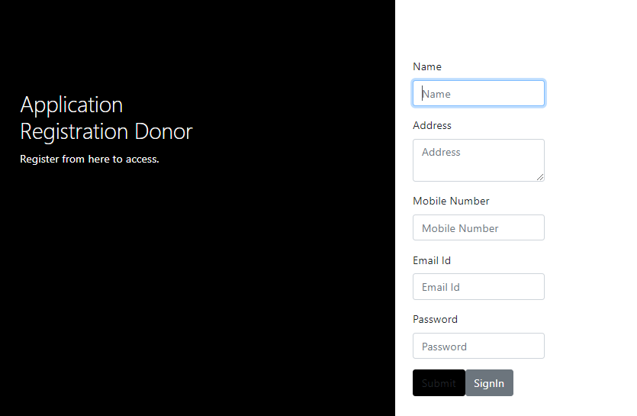
Donor Register Page:

Slide 11
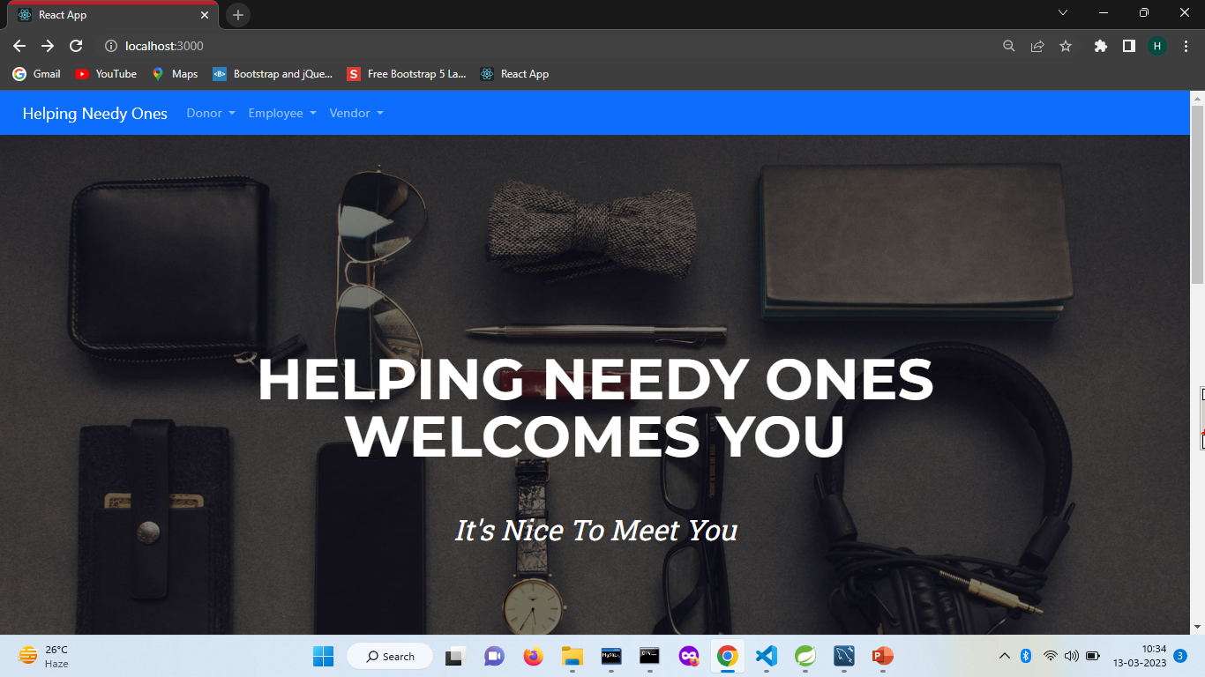
Working Photos: Landing Page

Slide 12
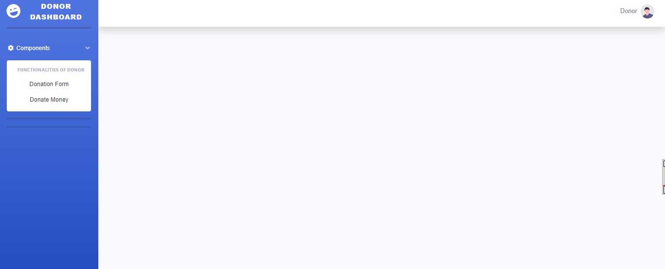
Donor Pages

Slide 13
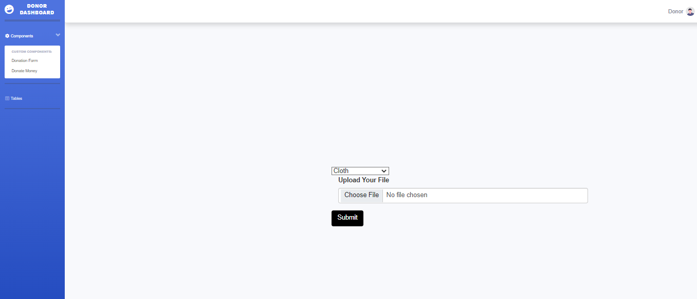

Slide 14
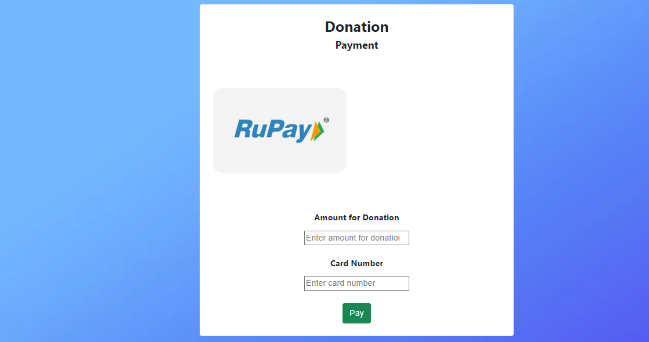

Slide 15
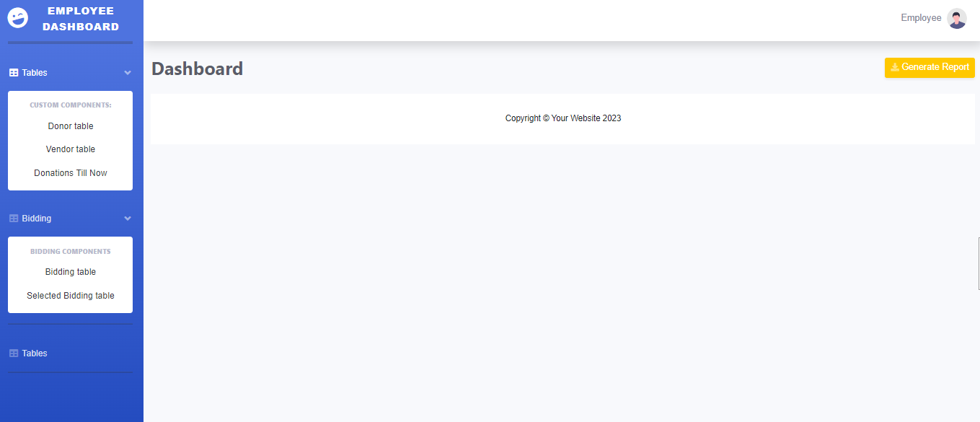
Employee

Slide 16
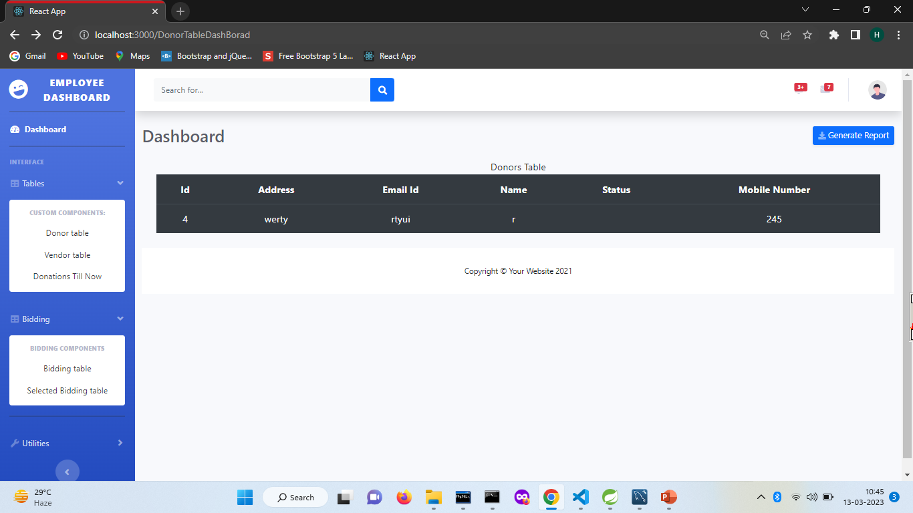

Slide 17
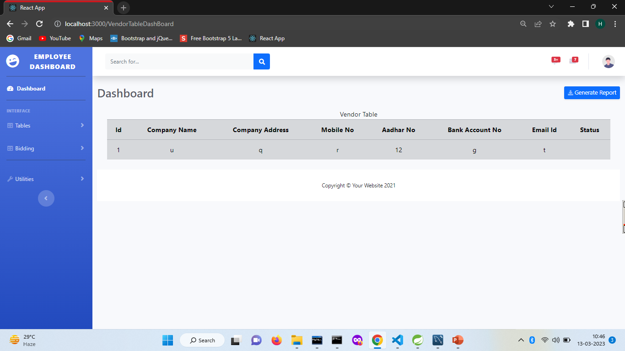

Slide 18
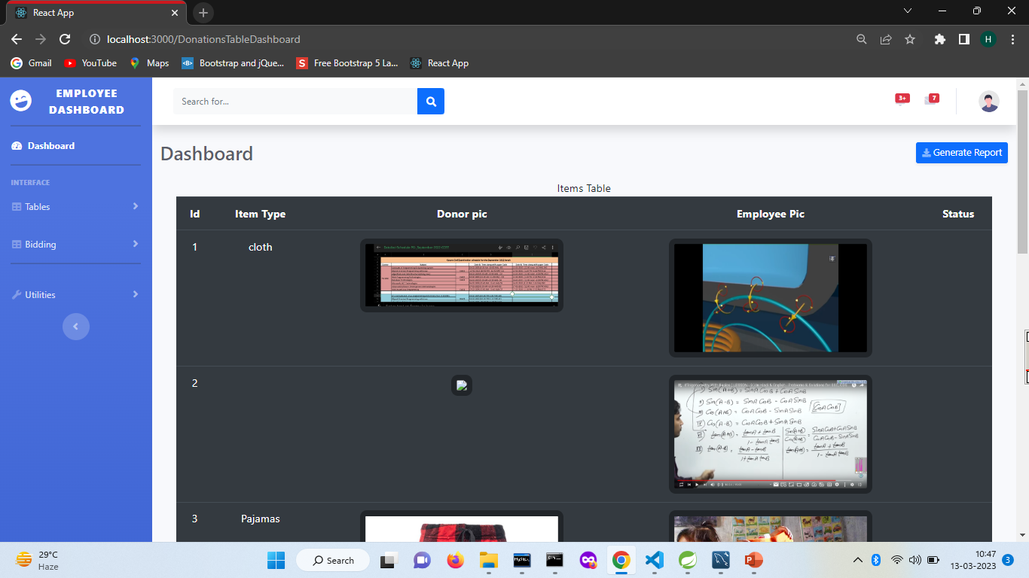

Slide 19
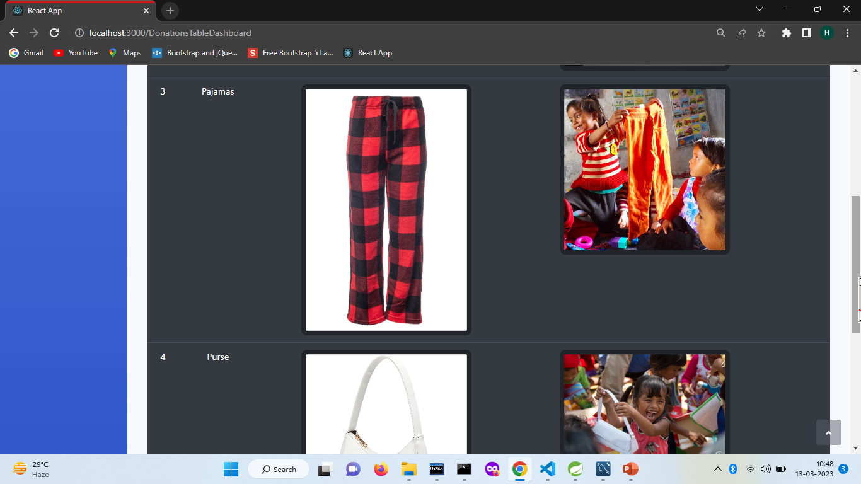

Slide 20
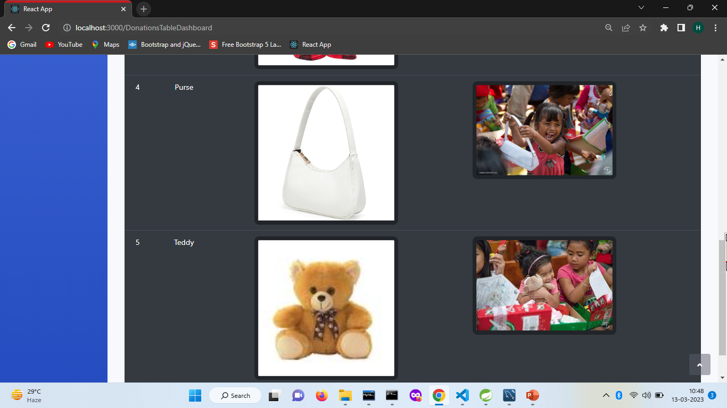

Slide 21
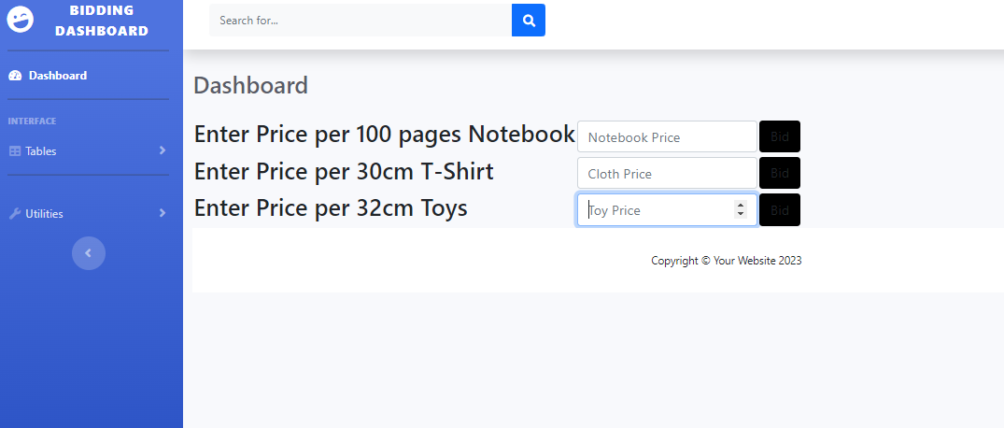
Vendor Pages

Slide 22
Future Scope:
There is a scope for further development in our project to a great extent. A number of features can be added to this system in future like using virtual and augmented reality technology, organizations could create immersive experiences that showcase their impact and encourage donations. Incorporating crowdfunding features could allow organizations to create campaigns for specific projects and receive donations from multiple donors.
Make the web application more attractive ,fast and responsive so that it would be more appealing for donor or vendor.
In future we will enhance our security with latest technology.

Slide 23
Conclusion:
The system has been developed with much care and free of errors and at the same time it is efficient and less time consuming. The purpose of this project was to develop a web application for donating items by donor. This project helped us in gaining valuable information and practical knowledge on several topics like designing web pages using React.js, usage of responsive templates, designing of web applications, and management of database using MySQL.
The entire system is secured. Also, the project helped us understanding about the development phases of a project and software development life cycle. We learned how to test different features of a project.
This project has given us great satisfaction in having designed an application which has features of donating items like cloths, books etc., transparency is maintained during vendor bidding, automatic bank transfer done when item received by employee through vendor.

Slide 24
GIT HUB PROJECT LINK:-
https://github.com/UtkarshUpadhyay1703/Helping-Needy-Ones

Slide 25
Thank You!

